Slide 1
Report
For Our Java Project

Slide 2

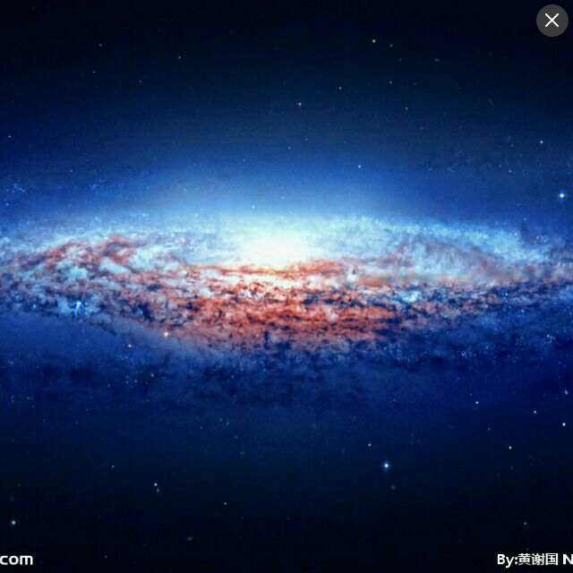

Members
李诗怡
11610511
孙渤恺
11611823
张 昀
11610606

Slide 3
Basic Functions
完备的基础功能

Slide 4
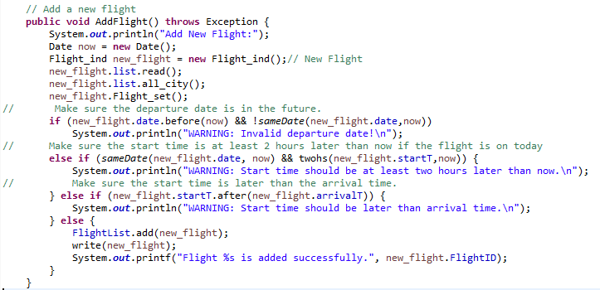
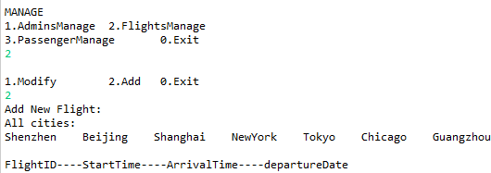
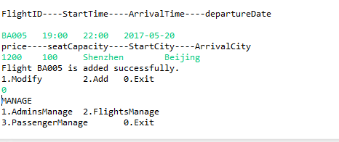
Create Flight
Create a new flight individual object first, and set its instance variables one by one, then check whether it is valid, finally add it to the list and write into the file or print the error information.
首先创建一个航班个体对象，逐个修改其属性值，随后检查其是否合格，最后决定添加至列表还是给出错误信息。

Slide 5
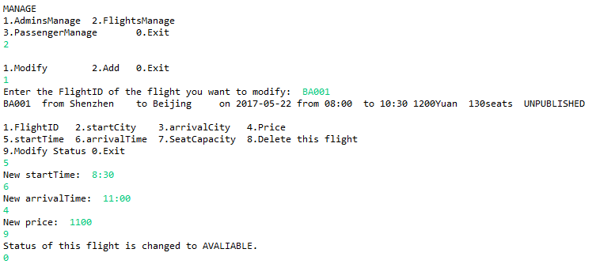
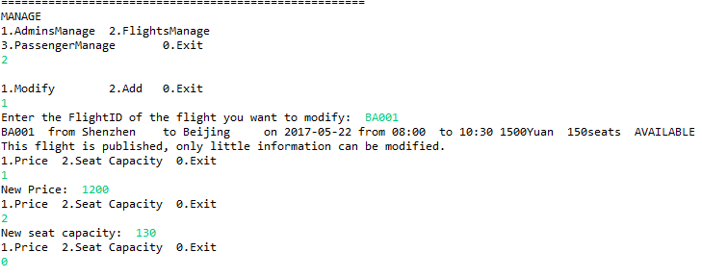
Update Flight
Unpublished case
First, check the status of the flight then provide options depending on the status. And change the choosing attributes and apply the changes to the file.
首先检查航班状态，根据其状态给出选项，随后修改被选中的属性并将修改覆盖到文件中。
Available case

Slide 6
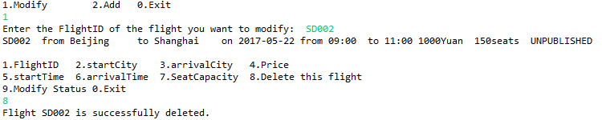
Delete Flight
Delete_Flight function is treated as a part of updating flight, and only the unpublished flight can be deleted. The flight is removed from the Flight_List then the file.
删除航班被认为是一种修改航班的操作, 只有未发布的航班可以被删除。首先将航班从航班列表中删除，然后在文件中将其去除。

Slide 7
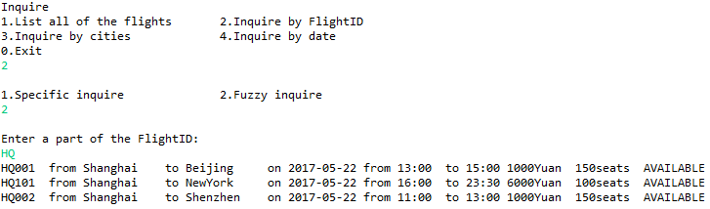
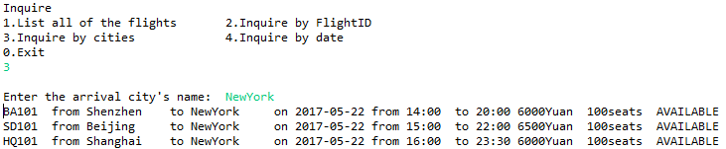
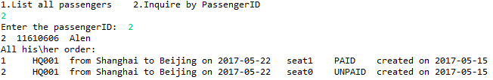
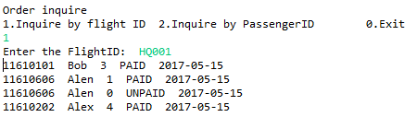
Super Query
Fuzzy inquire
When inquiring flights, program compares the condition given by user and of each flight, and check the status of the flight (terminate flight is not printed), then print the flights' information. When inquiring orders, program inspects the order list of all passengers and prints the needed order information.
查询航班时，程序比较输入的信息和每个航班的对应信息，检查航班状态（不打印终结状态的），然后决定是否打印该航班信息。查询订单时，程序检查每位乘客的订单列表，随后打印出被需求的订单信息。
Inquire by arrival city
Inquire a passenger’s information
Inquire a flight’s all orders

Slide 8
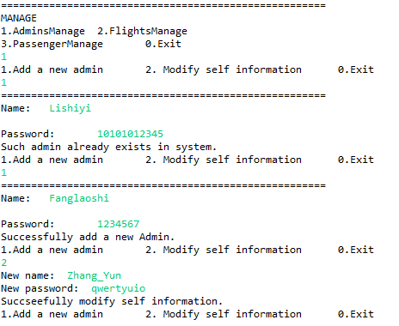
User Management
Admins can create new admin and modify self information. When creating admin, system can check whether such admin exist yet. And after the admin successful creating or self information is modified, changes will be added to the ArrayList and file.
管理员可以创建新管理员或修改个人信息。当创建新管理员时，系统会检查改管理员是否已经存在。在管理员被成功创建或信息被成功修改后，变更将会被应用到管理员列表和文件。

Slide 9
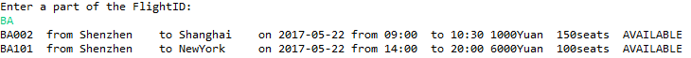
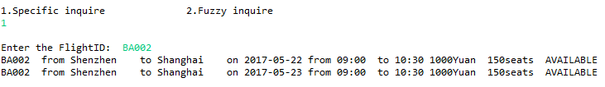
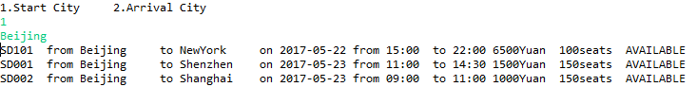


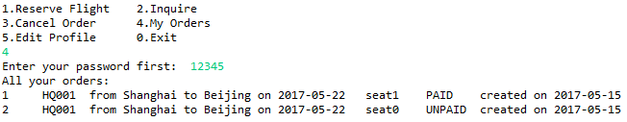
Query Flight
Fuzzy Inquire 1
First let the passage choose the attribute to inquire, and input the value. Then system will check each flight in the flight_list and decide whether it can be showed, which also depending on the status. As of fuzzy inquire, we use the contains method provided by String class. When passenger want to inquire his order, system would ask him to enter password first and then show all orders in his order list.
首先让乘客选择要查询的选项并输入对应的值，随后系统检查航班列表中的每一个航班并依据其状态和是否符合条件决定打印与否。至于模糊查询，我们使用了String类提供的contains()方法。当乘客查询其订单时，系统首先核验身份，随后打印出其订单列表中的所有订单。
Fuzzy Inquire 2
Specific Inquire
Inquire by start city
Inquire by arrival city
Inquire by departure date
Inquire self’s order

Slide 10
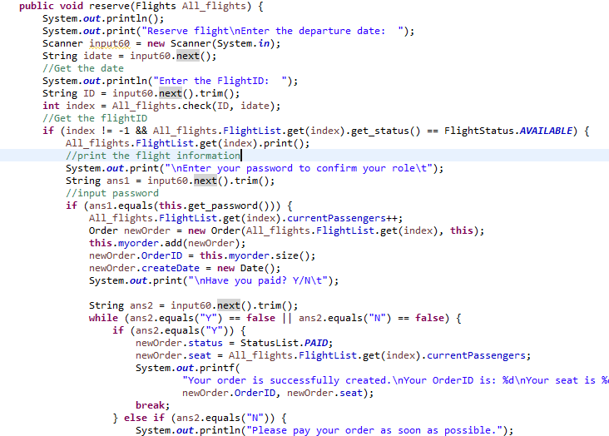
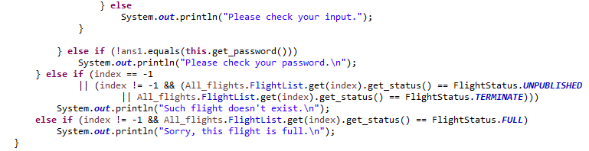
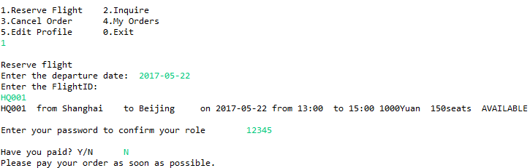
Reserve Flight
First, input the departure date of flight, then enter the flight ID, system will check whether a flight with such ID exist in the date inputted. Then print the flight information and check the password, and ask whether user has paid. Then creates an order and adds it to the passenger’s order list.
首先输入航班日期和航班ID，系统会检查在一天是否有这样的航班存在。若存在，则随后打印出该航班信息，检查用户身份，确认是否支付，然后创建订单并将其加入该乘客的订单列表。
OR

Slide 11
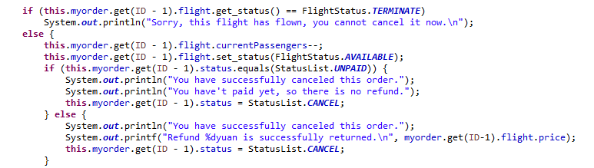


Unsubscribe Flight
First, the passenger input the order ID, then the system will check the status of the flight because once the flight is terminate, passenger cannot cancel the order any more. If not, system will remove the order from his/her order list and decrease the current passengers of the flight, also the flight status is changed to available. Then print the refund information depending on the order status.
首先由乘客输入订单号，系统检验该订单中的航班的状态，因为一旦航班终止乘客即无法退订，随后从订单列表中删去此订单并减少航班的当前乘客数、将航班状态改为可预订。然后依据订单状态打印相应的退款信息。
OR

Slide 12
Potential Bonus
潜在的加分项

Slide 13
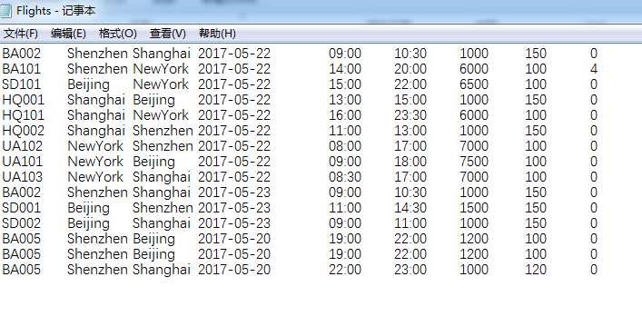
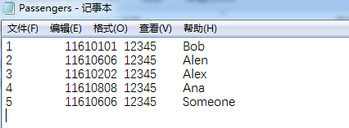
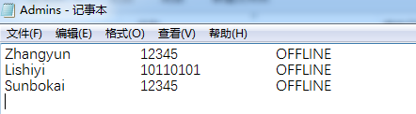
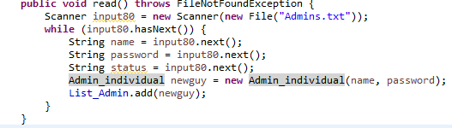
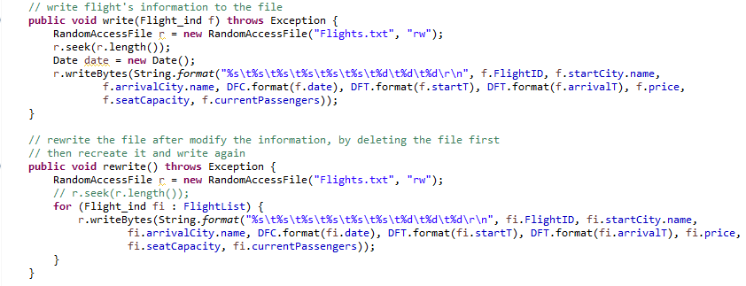
File IO
Use Scanner to read information from files, and RandomFileAccess to write information to the files. Once the system is started, data in the files would be read and added to the related list. Once new object is created or information is modified, the changes would be written into the files.
使用Scanner和RandomFileAccess来读写文件。当系统被启动时，文件中的数据会被读入相应的ArrayList里，当新对象被创建或信息被修改时，改变会被写入文件中。

Slide 14
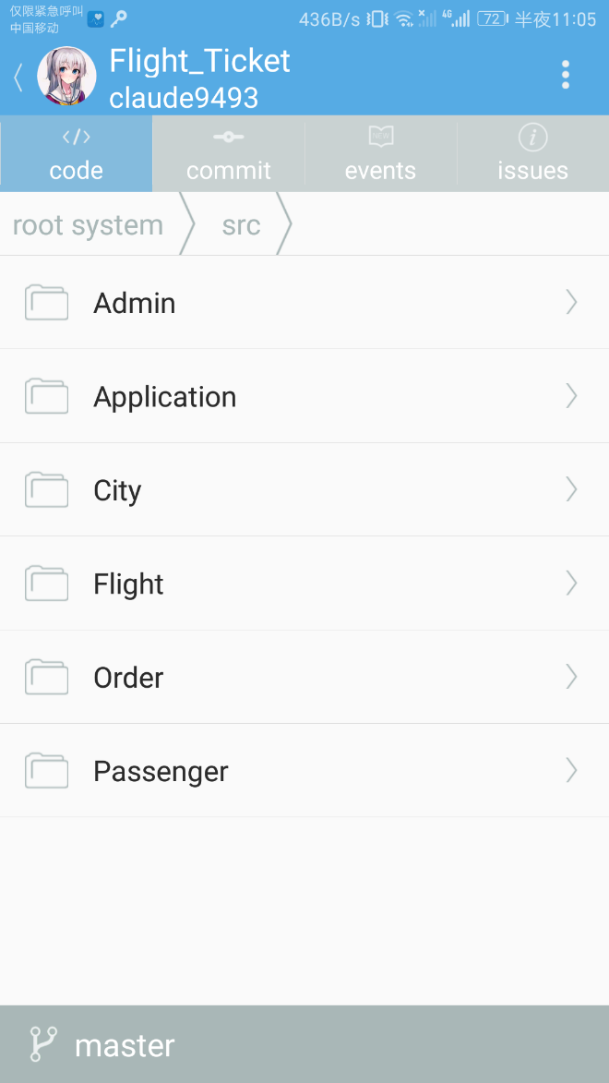
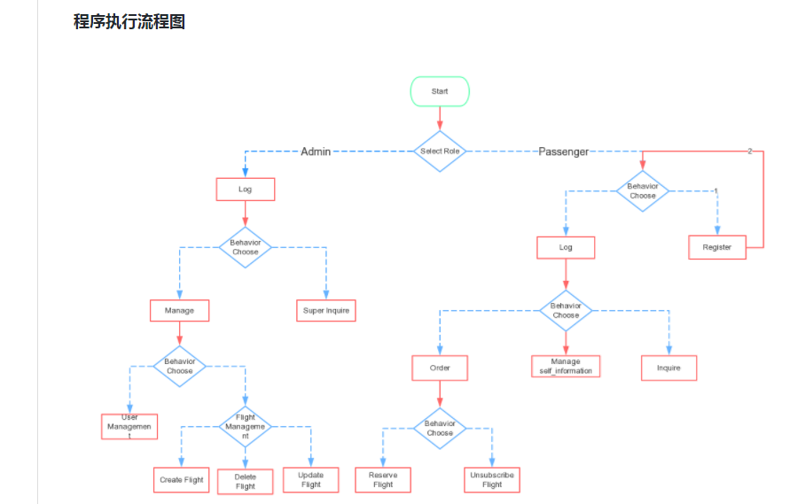
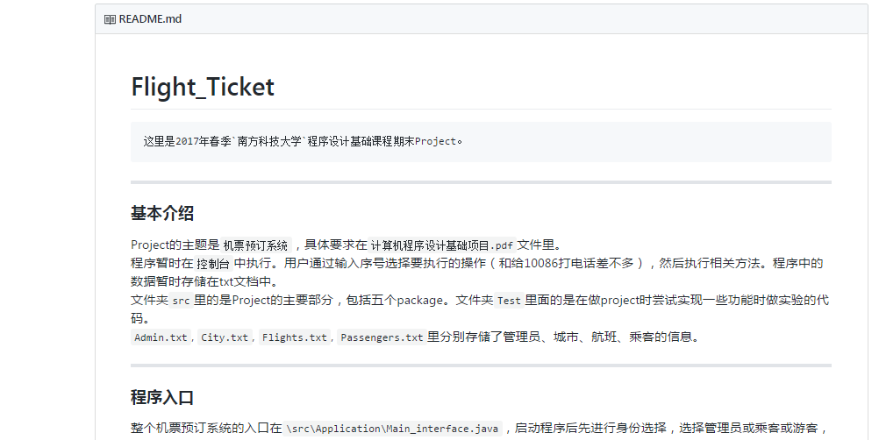
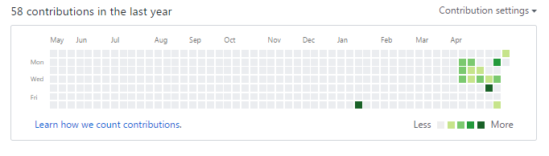
GitHub
We use GitHub to store our codes online and develop system together. We have a clear readme file and a diagram inside it. We also use the issue function to communicate and record the problems meted. When we commit our code, we can write some description to explain our works.
我们使用GitHub存储代码和协作开发。我们有清晰的README，其中还有张清楚的流程图。我们也利用issue功能来交流与记录开发过程中遇到的问题。当我们提交代码至云端时，我们也会写一些描述来总结我们的工作。

Slide 15
THANKYOU

